Slide 1
Toolformer: Language Models Can Teach Themselves to Use Tools
Timo Schick Jane Dwivedi-Yu Roberto Dessì† Roberta Raileanu
Maria Lomeli Luke Zettlemoyer Nicola Cancedda Thomas Scialom
Meta AI Research †Universitat Pompeu Fabr
9 Feb 2023
arxiv.org/pdf/2302.04761.pdf
Notes:
Language models (LMs) exhibit remarkable abilities to solve new tasks from just a few examples or textual instructions, especially at scale. They also, paradoxically, struggle with basic functionality, such as arithmetic or factual lookup, where much simpler and smaller models excel.

Slide 2
Table of contents
Clarify the researcher's ideas
Experiments & My comments
Implement (code)

Slide 3
Clarify the researcher's ideas

Slide 4
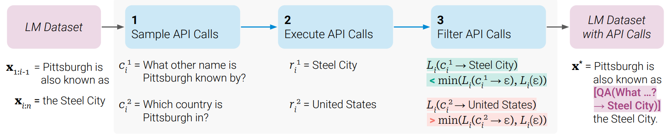
approach
Sampling API Calls
Executing API Calls
Filtering API Calls
Model Finetuning
Inference
Key steps for question answering tool

Slide 5
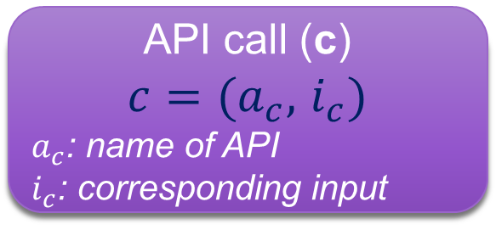
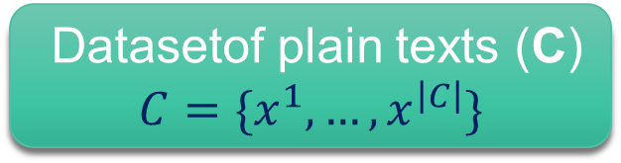
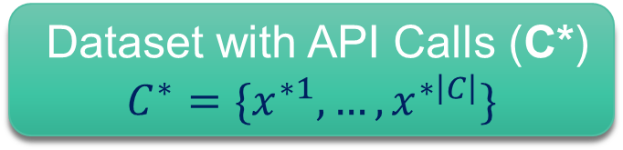
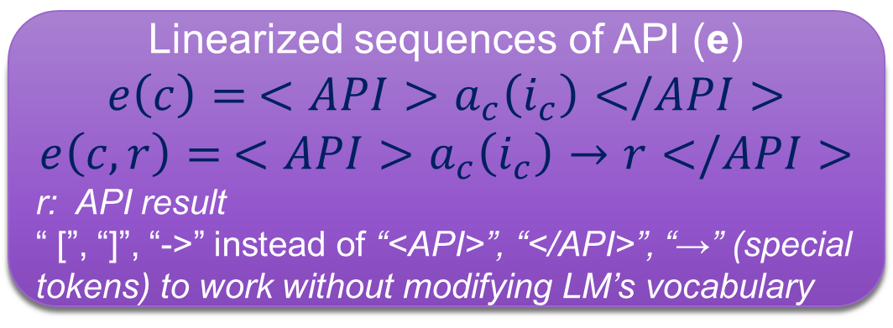
approach
API call (c)
${c=(a}_{c},$ $i_{c})$
$a_{c}$: name of API
$i_{c}$: corresponding input
Datasetof plain texts (C)
$$C=\{x^{1},…, x^{\left|C\right|}\}$$
Linearized sequences of API (e)
$${e\left(c\right)= <API>a}_{c}\left(i_{c}\right)</API>$$
$${e\left(c,r\right)= <API>a}_{c}\left(i_{c}\right)→r</API>$$
r: API result
“ [”, “]”, “->” instead of “<API>”, “</API>”, “→” (special tokens) to work without modifying LM’s vocabulary
Dataset with API Calls (C*)
$$C^{∗}=\{x^{∗1},…, x^{∗\left|C\right|}\}$$
Finetuning language model M on C*
C* contains the exact same texts as C

Slide 6
Step by step
Sampling API Calls
Executing API Calls
Filtering API Calls
Model Finetuning
Inference

Slide 7
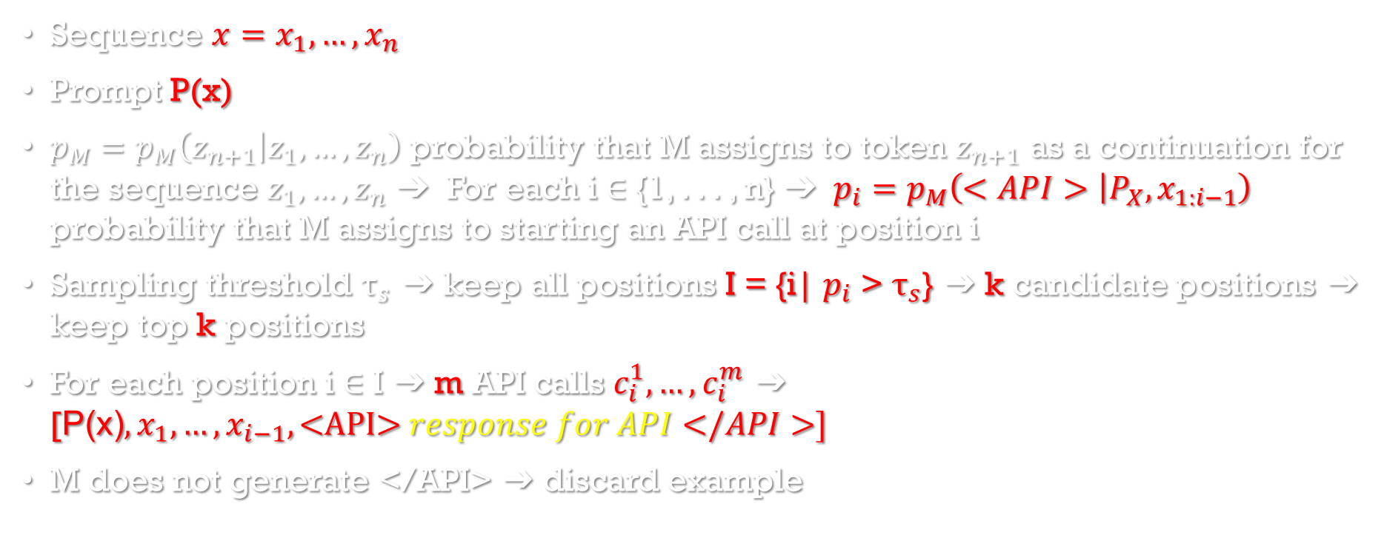
Sampling API Calls
Sampling API Calls
Executing API Calls
Filtering API Calls
Sequence $x=x_{1},…, x_{n}$
Prompt P(x)
$p_{M}=p_{M}\left(z_{n+1} | z_{1}, …,z_{n}\right)$ probability that M assigns to token $z_{n+1}$ as a continuation for the sequence $z_{1}, …,z_{n}$ ➔ For each i ∈ {1, . . . , n} ➔ $p_{i}=p_{M}\left(<API> | P_{X}, x_{1:i−1}\right)$ probability that M assigns to starting an API call at position i
Sampling threshold ${\text{τ}}_{s}$ ➔ keep all positions I = {i| $p_{i}$ > ${\text{τ}}_{s}$} ➔ k candidate positions ➔ keep top k positions
For each position i ∈ I ➔ m API calls $c_{i}^{1},…,c_{i}^{m}$ ➔ [$\text{P}\text{(}\text{x}\text{)},x_{1},…,x_{i−1},\text{<}\text{API}\text{>} response for API</API>]$
M does not generate </API> ➔ discard example

Slide 8
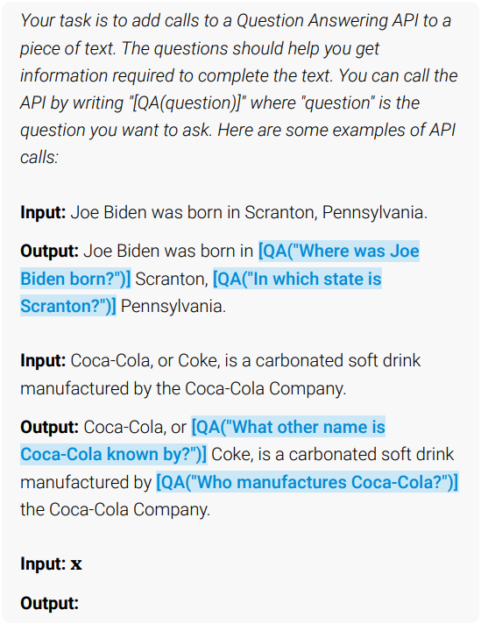
Prompt P(x)
Question Answering (2)
Calculator (5)
Wikipedia Search (3)
Machine Translation System (3)
Calendar (5)

Slide 9
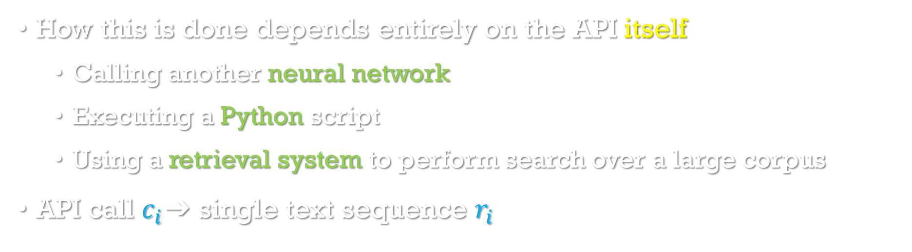
Executing API Calls
Sampling API Calls
Executing API Calls
Filtering API Calls
How this is done depends entirely on the API itself
Calling another neural network
Executing a Python script
Using a retrieval system to perform search over a large corpus
API call $c_{i}$➔ single text sequence $r_{i}$

Slide 10
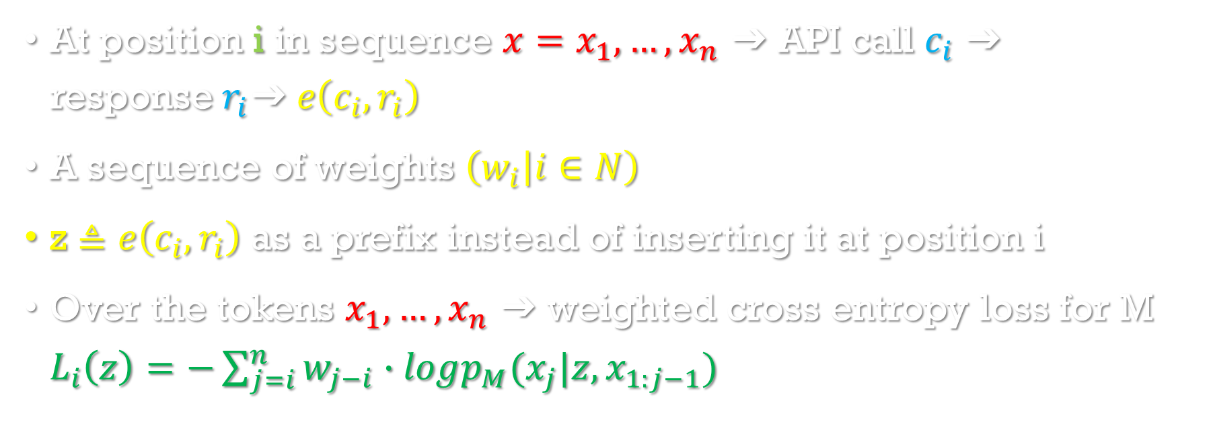
Filtering API Calls
Sampling API Calls
Executing API Calls
Filtering API Calls
At position i in sequence $x=x_{1},…, x_{n}$ ➔ API call $c_{i}$ ➔ response$r_{i}$➔$e\left(c_{i},r_{i}\right)$
A sequence of weights $\left(w_{i} | i∈N\right)$
z $≜e\left(c_{i},r_{i}\right)$ as a prefix instead of inserting it at position i
Over the tokens $x_{1},…, x_{n}$ ➔ weighted cross entropy loss for M $L_{i}\left(z\right)=−\sum_{j=i}^{n}{w_{j−i}∙logp_{M}(x_{j}|z,x_{1:j−1})}$
Notes:
We provide e(ci, ri) as a prefix instead of inserting it at position i because M is not yet finetuned on any examples containing API calls, so inserting it in the middle of x would interrupt the flow and not align with patterns in the pretraining corpus, thus hurting perplexity

Slide 11
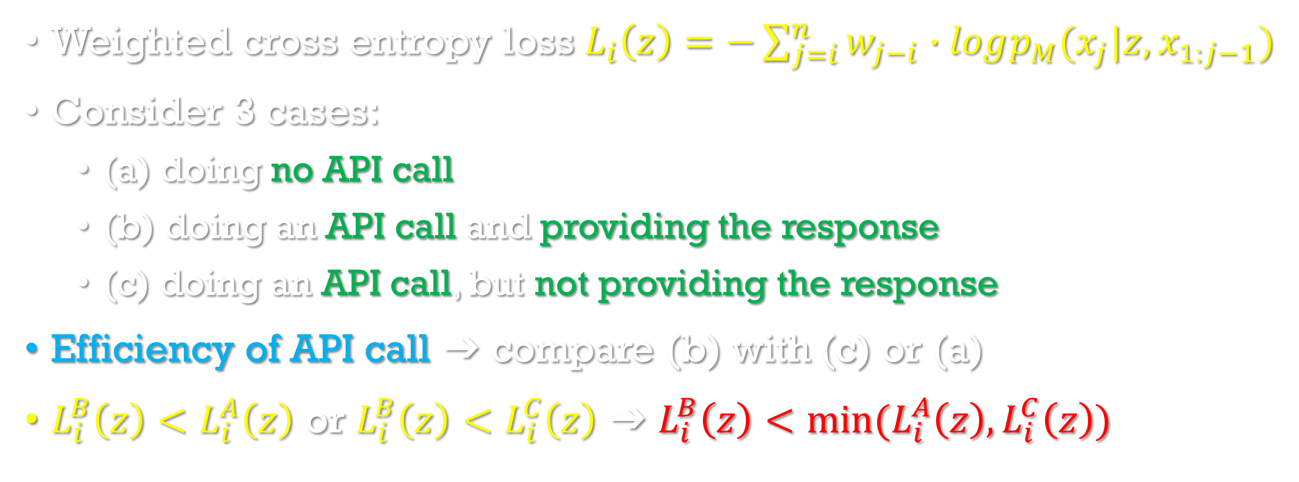
Filtering API Calls
Sampling API Calls
Executing API Calls
Filtering API Calls
Weighted cross entropy loss $L_{i}\left(z\right)=−\sum_{j=i}^{n}{w_{j−i}∙logp_{M}(x_{j}|z,x_{1:j−1})}$
Consider 3 cases:
(a) doing no API call
(b) doing an API call and providing the response
(c) doing an API call, but not providing the response
Efficiency of API call ➔ compare (b) with (c) or (a)
$L_{i}^{B}\left(z\right)<L_{i}^{A}\left(z\right)$ or $L_{i}^{B}\left(z\right)<L_{i}^{C}\left(z\right)$ ➔ $L_{i}^{B}\left(z\right)<min⁡(L_{i}^{A}\left(z\right),L_{i}^{C}\left(z\right))$

Slide 12
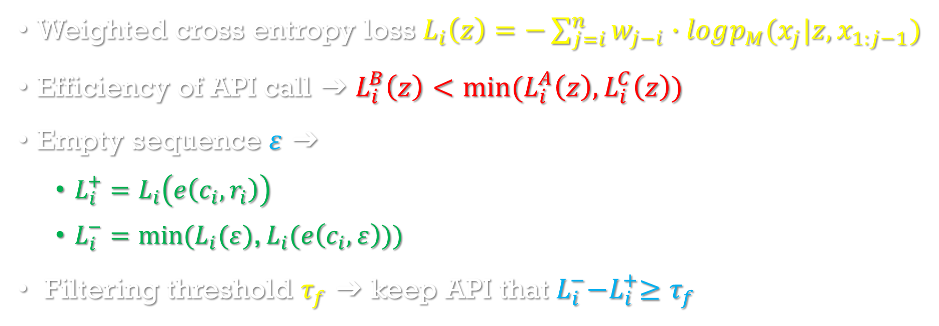
Filtering API Calls
Sampling API Calls
Executing API Calls
Filtering API Calls
Weighted cross entropy loss $L_{i}\left(z\right)=−\sum_{j=i}^{n}{w_{j−i}∙logp_{M}(x_{j}|z,x_{1:j−1})}$
Efficiency of API call ➔ $L_{i}^{B}\left(z\right)<min⁡(L_{i}^{A}\left(z\right),L_{i}^{C}\left(z\right))$
Empty sequence $ε$ ➔
$L_{i}^{+}=L_{i}\left(e\left(c_{i},r_{i}\right)\right)$
$L_{i}^{−}=min⁡(L_{i}(ε)$, $L_{i}(e\left(c_{i},ε\right)))$
Filtering threshold $τ_{f}$ ➔ keep API that $L_{i}^{−}{−L}_{i}^{+}≥τ_{f}$

Slide 13
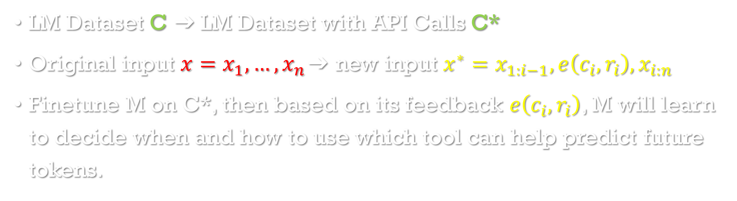
Model Finetuning
LM Dataset C $\text{➔}$LM Dataset with API Calls C*
Original input $x=x_{1},…, x_{n}\text{➔}$ new input $x^{∗}=x_{1:i−1},e\left(c_{i},r_{i}\right),x_{i:n}$
Finetune M on C*, then based on its feedback $e\left(c_{i},r_{i}\right)$, M will learn to decide when and how to use which tool can help predict future tokens.

Slide 14
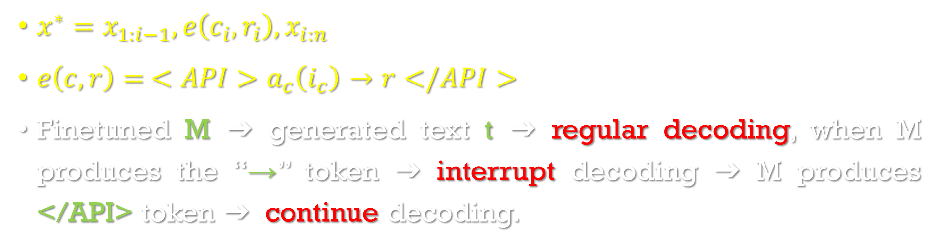
Inference
$x^{∗}=x_{1:i−1},e\left(c_{i},r_{i}\right),x_{i:n}$
${e\left(c,r\right)= <API>a}_{c}\left(i_{c}\right)→r</API>$
Finetuned M ➔ generated text t ➔ regular decoding, when M produces the “→” token ➔ interrupt decoding ➔ M produces </API> token ➔ continue decoding.

Slide 15
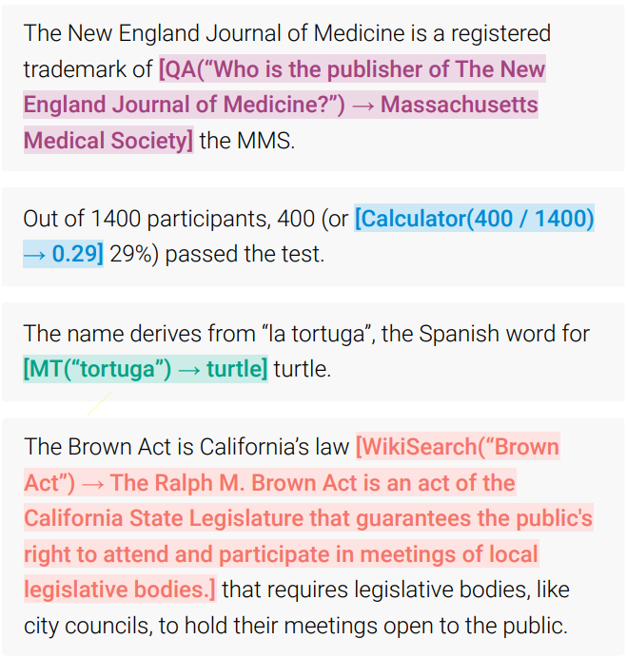
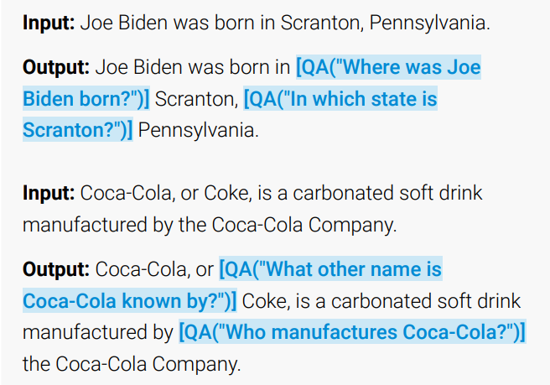
Inference
Fine-tuning

Slide 16
Tools
Question Answering
QA system based on another LM - Atlas retrieval-augmented LM fine-tuned on Natural Questions
Calculator
Simple numeric calculations - four operations, rounded to two decimal places
Wikipedia Search
Search engine, given a search term, extract from comprehensive information and returns short text - a BM25 retriever that indexes the Wikipedia dump from KILT
Machine Translation System
Detect source language using the fast-Text classifier, translate into English from any language using multilingual machine translation model - 600M parameter NLLB (200 languages)
Calendar
Query, return the current date without taking any inputs, provide temporal context for predictions that require some awareness of time

Slide 17
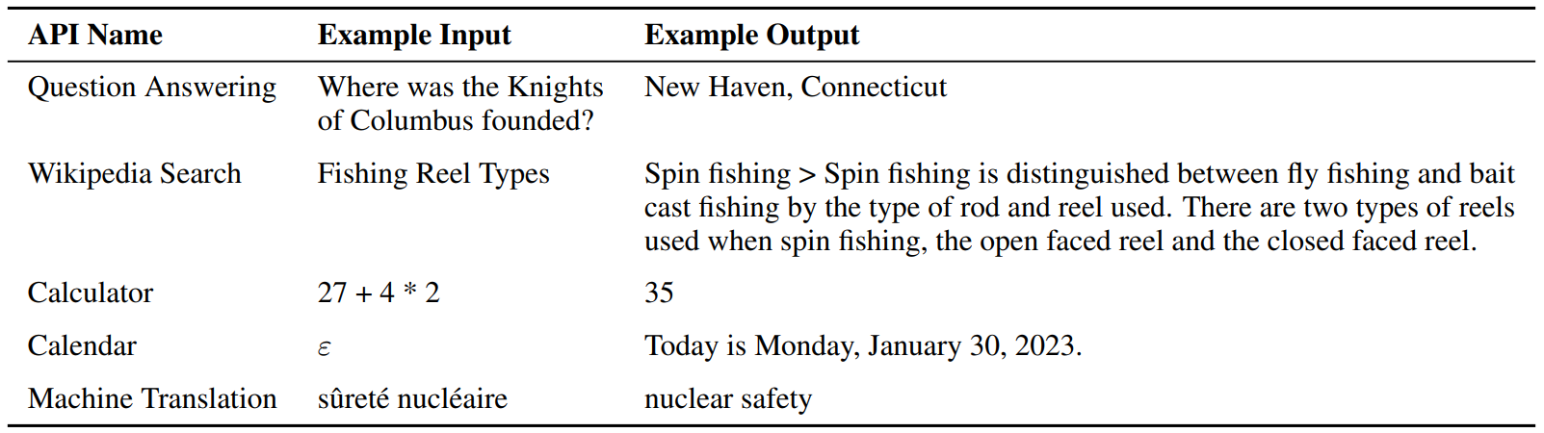

Slide 18
Experiments & My comments

Slide 19
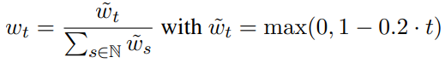
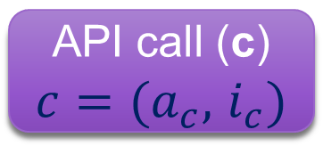
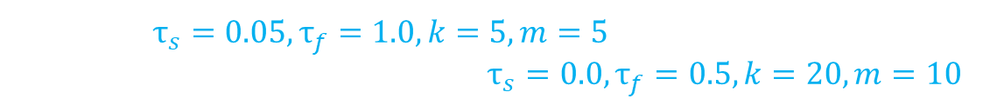
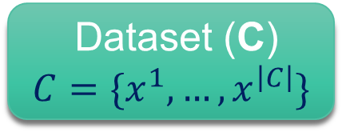
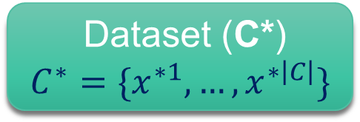
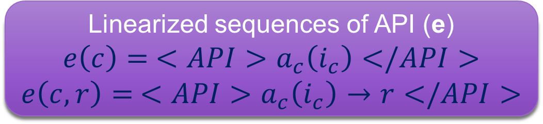
Computational cost ➔ define heuristics
Subset of CCNet
Default: ${\text{τ}}_{s}=0.05,{\text{τ}}_{f}=1.0,k=5,m=5$
Calculator, machine translation: ${\text{τ}}_{s}=0.0,{\text{τ}}_{f}=0.5,k=20,m=10$
Dataset (C)
$$C=\{x^{1},…, x^{\left|C\right|}\}$$
API call (c)
${c=(a}_{c},$ $i_{c})$
obtaining C* from C
Linearized sequences of API (e)
$${e\left(c\right)= <API>a}_{c}\left(i_{c}\right)</API>$$
$${e\left(c,r\right)= <API>a}_{c}\left(i_{c}\right)→r</API>$$
Dataset (C*)
$$C^{∗}=\{x^{∗1},…, x^{∗\left|C\right|}\}$$
more likely
to be helpful
batch size: 128
learning rate: 1·10−5
linear warmup: first 10% of training
Finetuning M on C*
Make sure that API is actually helpful ➔ weighting function
GPT-J
• GPT-J: w/o finetuning
• GPT-J + CC: finetuned on C
• Toolformer: GPT-J finetuned on C*
• Toolformer (disabled): disable API calls (decode)
Notes:
heuristics - A technique designed for solving a problem when classic methods are too slow or fail to find any exact solution

Slide 20
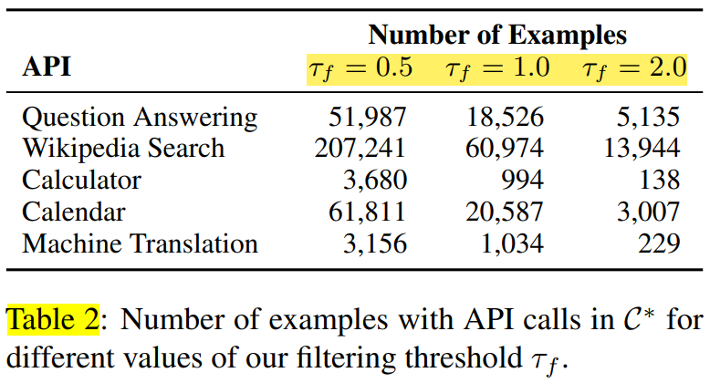
Filtering threshold $τ_{f}$ ➔ keep API that $L_{i}^{−}{−L}_{i}^{+}=τ_{f}$

Slide 21
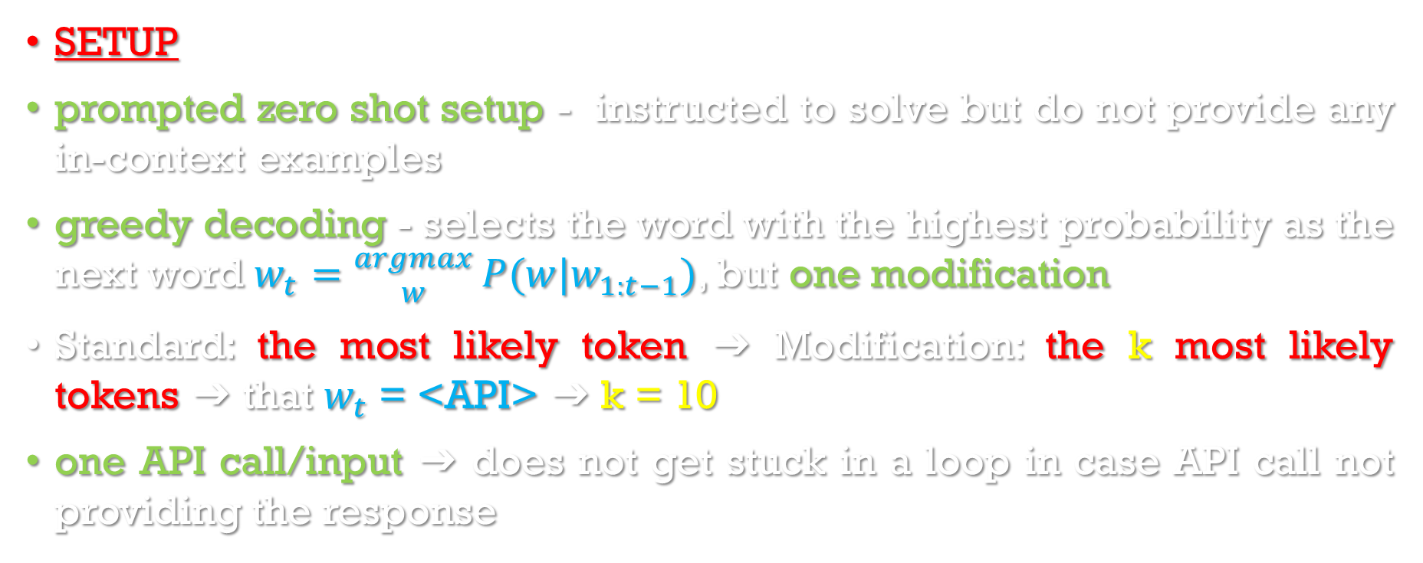
Downstream Tasks
SETUP
prompted zero shot setup - instructed to solve but do not provide any in-context examples
greedy decoding - selects the word with the highest probability as the next word $w_{t}={argmax \atop w}P(w|w_{1:t−1})$, but one modification
Standard: the most likely token ➔ Modification: the k most likely tokens ➔ that $w_{t}$ = <API> ➔ k = 10
one API call/input ➔ does not get stuck in a loop in case API call not providing the response

Slide 22
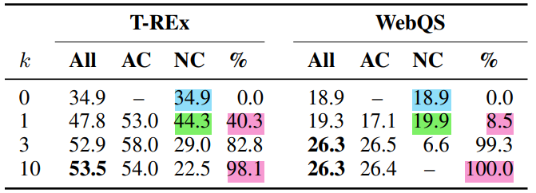
Downstream Tasks
Standard: the most likely token ➔ Modification: the k most likely tokens ➔ that $w_{t}$ = <API> ➔ k = 10
increasing k ➔ model doing API calls for more examples
k = 1 ➔ model is calibrated to some extent ➔ decide to call APIs (better perform) instead of NOT call APIs (badly perform). higher values of k ➔ lose this calibration

Slide 23
evaluate models
Considering the following criterions:
The factual and commonsense knowledge contained in pretrained language models (on SQuAD, Google RE and T-REx subsets of the LAMA)
Performance on specific tasks when compared with other models
Mathematical reasoning abilities on ASDiv, SVAMP, MAWPS
Question Answering on Web Questions, Natural Questions, TriviaQA
Multilingual Question Answering on MLQA
Calendar API’s utility on TEMPLAMA, generated DATESET
Language modeling performance on WikiText, CCNet not used in training (10,000)
Ability to ask external tools for help affects performance using GPT-J and GPT-2 family (124M, 355M, 775M, 1.6B) for tools: question answering, calculator, Wikipedia search.

Slide 24
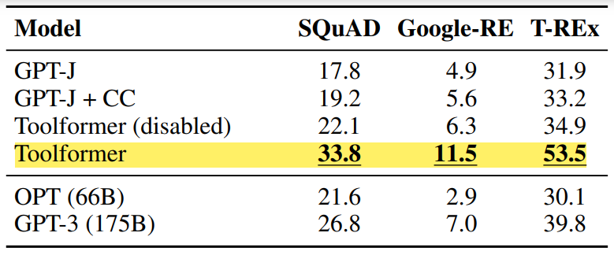
Downstream Tasks
The factual and commonsense knowledge on SQuAD, Google RE and T-REx subsets of the LAMA
Task: complete a short statement with a missing fact (e.g., a date or a place)
question answering tool (98.1%); a different tool (0.7%) or no tool (1.2%)
LAMA was designed to evaluate masked language models ➔ filter out mask token is not the final token. Lenient evaluation criteria instead of exact match, the correct word is in the top five predicted words.
LAMA is based on statements (Wikipedia), prevent Toolformer from using the Wikipedia Search API

Slide 25
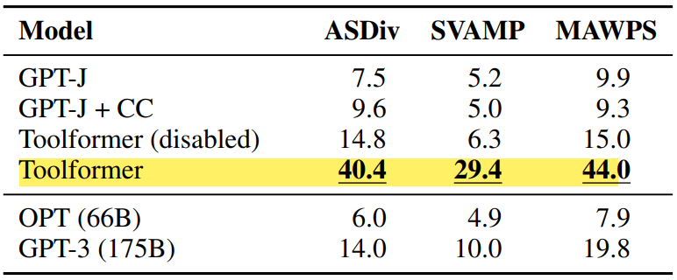
Downstream Tasks
Performance on specific tasks
Mathematical reasoning abilities on ASDiv, SVAMP, MAWPS
Operations: “+”, “−”, “∗”, “/”
Heuristic filters for CCNet & processing criterions
window of 100 tokens ➔ >= 3 numbers, one is the result of the operation of the other two.
“=”, “equals”, “equal to”, “total of”, “average of” + a number
>= 3 numbers (random 1%)
calculator tool (97.9%)
Lenient evaluation criterion, output is a number ➔ check for the first predicted number
Surmise: finetuned on many examples of API calls and their results ➔ improving mathematical capabilities

Slide 26
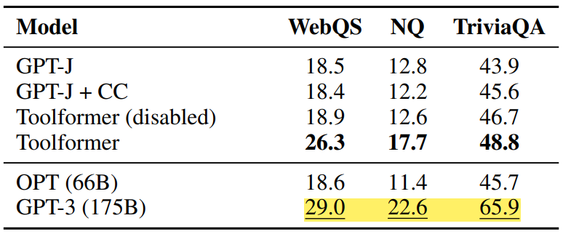
Downstream Tasks
Performance on specific tasks
Question Answering on Web Questions, Natural Questions, TriviaQA
Simplicity (not a good match)
Inability to interact with itself, reformulating or browsing through the top results ➔ future work
Wikipedia search (99.3%)
Lenient evaluation criteria instead of exact match, the correct word is in the top 20 predicted words.
Question-answering tool: Atlas model finetuned on Natural Questions. Atlas large (obtaining C*), Atlas-xxl (Inference) ➔ task solving is trivial ➔ disable question-answering tool

Slide 27
Downstream Tasks
Performance on specific tasks
Multilingual Question Answering on MLQA
Machine translation tool: NLLB 600M (training & inference), fastText classifier (source language detection)
Text chunks (multilingual language) ➔ target language (English)
Preprocessing:
Text chunks size: 10 tokens
Middle text chunk is in a language other than English (fastText classifier, confidence > 0.8)
Any text chunks only numbers or special symbols
Input: 近年来，科学家们根据蛋白质的结构创作了音乐，作为更好地向公众普及科学的创造性方式，但由此产生的歌曲并不总是悦耳 En un estudio que aparece el 29 de septiembre en la revista Heliyon, los investigadores utilizan el estilo de los géneros musicales existentes para guiar la estructura de las canciones proteicas y hacerlas más musicales 研究人员以肖邦的幻想即兴曲和其他古典作品的风格为指导，将蛋白质转化为具有巨大音乐性的歌曲
Notes:
While during data generation the model can look ahead to generate API calls, this is not possible at inference time, so we want to dissuade the model from calling the API in such cases

Slide 28
Downstream Tasks
Performance on specific tasks
Multilingual Question Answering on MLQA
Input ➔ API calls (Machine translation tool) ➔ 近年来，科学家们根据蛋白质的结构创作了音乐，作为更好地向公众普及科学的创造性方式，但由此产生的歌曲并不总是悦耳 <API> response of API </API> En un estudio que aparece el 29 de septiembre en la revista Heliyon, los investigadores utilizan el estilo de los géneros musicales existentes para guiar la estructura de las canciones proteicas y hacerlas más musicales <API> response of API </API> 研究人员以肖邦的幻想即兴曲和其他古典作品的风格为指导，将蛋白质转化为具有巨大音乐性的歌曲 <API> response of API </API>
<API> response of API </API>
近年来，科学家们根据蛋白质的结构创作了音乐，作为更好地向公众普及科学的创造性方式，但由此产生的歌曲并不总是悦耳 <API> response of API </API> En un estudio que aparece el 29 de septiembre en la revista Heliyon, los investigadores utilizan el estilo de los géneros musicales existentes para guiar la estructura de las canciones proteicas y hacerlas más musicales 研究人员以肖邦的幻想即兴曲和其他古典作品的风格为指导，将蛋白质转化为具有巨大音乐性的歌曲
Notes:
While during data generation the model can look ahead to generate API calls, this is not possible at inference time, so we want to dissuade the model from calling the API in such cases

Slide 29
Downstream Tasks
Performance on specific tasks
Multilingual Question Answering on MLQA
Input ➔ API calls (Machine translation tool) ➔ 近年来，科学家们根据蛋白质的结构创作了音乐，作为更好地向公众普及科学的创造性方式，但由此产生的歌曲并不总是悦耳 <API> response of API </API> En un estudio que aparece el 29 de septiembre en la revista Heliyon, los investigadores utilizan el estilo de los géneros musicales existentes para guiar la estructura de las canciones proteicas y hacerlas más musicales <API> response of API </API> 研究人员以肖邦的幻想即兴曲和其他古典作品的风格为指导，将蛋白质转化为具有巨大音乐性的歌曲 <API> response of API </API>
<API> response of API </API>
近年来，科学家们根据蛋白质的结构创作了音乐，作为更好地向公众普及科学的创造性方式，但由此产生的歌曲并不总是悦耳 En un estudio que aparece el 29 de septiembre en la revista Heliyon, los investigadores utilizan el estilo de los géneros musicales existentes para guiar la estructura de las canciones proteicas y hacerlas más musicales <API> response of API </API> 研究人员以肖邦的幻想即兴曲和其他古典作品的风格为指导，将蛋白质转化为具有巨大音乐性的歌曲
Notes:
While during data generation the model can look ahead to generate API calls, this is not possible at inference time, so we want to dissuade the model from calling the API in such cases

Slide 30
Downstream Tasks
Performance on specific tasks
Multilingual Question Answering on MLQA
Input ➔ API calls (Machine translation tool) ➔ 近年来，科学家们根据蛋白质的结构创作了音乐，作为更好地向公众普及科学的创造性方式，但由此产生的歌曲并不总是悦耳 <API> response of API </API> En un estudio que aparece el 29 de septiembre en la revista Heliyon, los investigadores utilizan el estilo de los géneros musicales existentes para guiar la estructura de las canciones proteicas y hacerlas más musicales <API> response of API </API> 研究人员以肖邦的幻想即兴曲和其他古典作品的风格为指导，将蛋白质转化为具有巨大音乐性的歌曲 <API> response of API </API>
<API> response of API </API>
近年来，科学家们根据蛋白质的结构创作了音乐，作为更好地向公众普及科学的创造性方式，但由此产生的歌曲并不总是悦耳 En un estudio que aparece el 29 de septiembre en la revista Heliyon, los investigadores utilizan el estilo de los géneros musicales existentes para guiar la estructura de las canciones proteicas y hacerlas más musicales 研究人员以肖邦的幻想即兴曲和其他古典作品的风格为指导，将蛋白质转化为具有巨大音乐性的歌曲 <API> response of API </API>
Notes:
While during data generation the model can look ahead to generate API calls, this is not possible at inference time, so we want to dissuade the model from calling the API in such cases

Slide 31
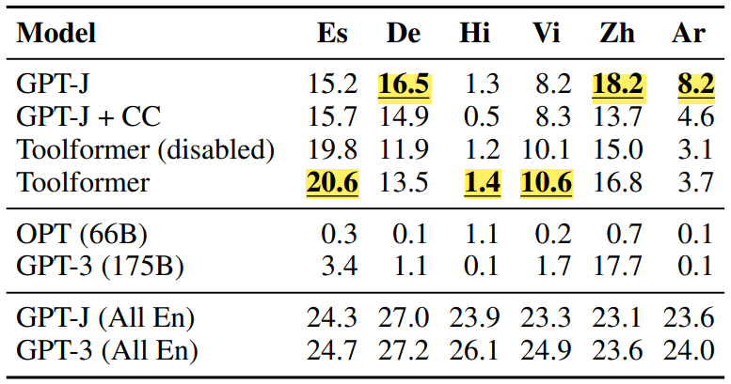
Downstream Tasks
Performance on specific tasks
Multilingual Question Answering on MLQA
*Distribution shift: CCNet compared to GPT-J’s original pretraining data
*Multilingual aspect: OPT and GPT-3 fail to provide answers in English with language differences between context and question.
Context and question in English ➔ best performance (GPT-3)
Machine translation tool (63.8-94.9%), Hindi (7.3%)
Context in English, question in Arabic, German, Spanish, Hindi, Vietnamese, Simplified Chinese ➔ understand paragraph and question. Percentage of times that correct word is in the top 10 predicted words.
Notes:
Spanish (Es), German (De), Hindi (Hi), Vietnamese (Vi), Chinese (Zh) and Arabic (Ar)

Slide 32
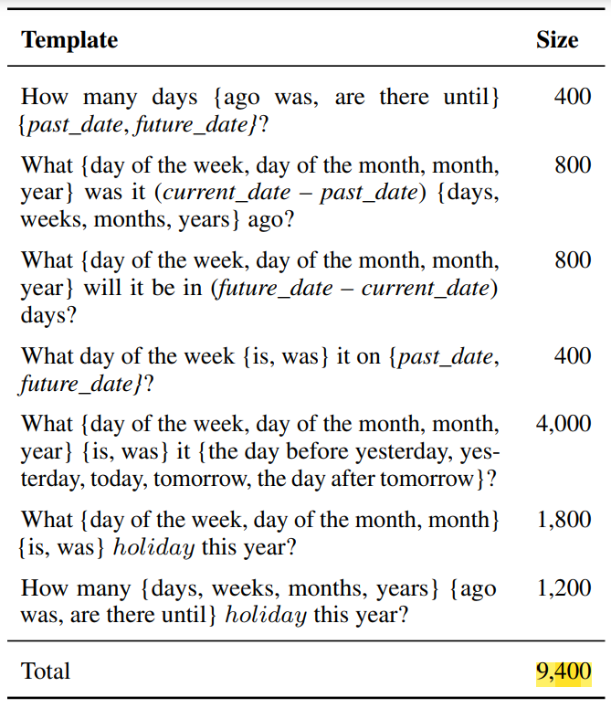
Downstream Tasks
Performance on specific tasks
Calendar API’s utility
TEMPLAMA (Wikidata) contains cloze queries about facts that change with time.
DATESET generated through a series of templates, but populated using a combination of random dates/durations.
Randomly 500 “current dates” ➔ randomly within four-year range “past date” and “future date” ➔ fill templates
Assumption: The calendar date is created document date. Extract from the URL, if present. Otherwise, filter out and leave ~18%.

Slide 33
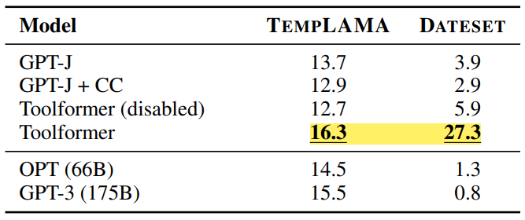
Downstream Tasks
Performance on specific tasks
Calendar API’s utility on TEMPLAMA, generated DATESET
A little help (exact date) because of specific and rare on TEMPLAMA
The best action: query current date (calendar), then query question answering with this date. But two API calls per example & Independently sampled API calls on training.
Mostly to Wikipedia search and question answering, calendar (0.2%) for TEMPLAMA. But calendar (54.8%) for DATESET.
Lenient evaluation criteria instead of exact match, the correct word is in the top five predicted words.

Slide 34
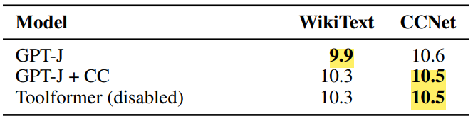
Downstream Tasks
Language modeling performance on WikiText, CCNet not used in training (10,000)
Original pretraining data for GPT-J is more similar to WikiText than randomly subset of CCNet. Training on C* compared to C does not lead to an increase in perplexity when API calls are disabled at inference time.
Ability to ask external tools for help affects performance using GPT-J and GPT-2 family (124M, 355M, 775M, 1.6B) for tools: question answering, calculator, Wikipedia search engine
Leverage the provided tools at models ~775M. Smaller models achieve similar performance w/ and w/o tools. But achieve difference for QA benchmarks (Wikipedia search engine mainly be used).
When the model size grows, it can solve tasks without API calls. So, it also can make good use of the provided API. And the gap between model predictions with and without API calls remains high.

Slide 35
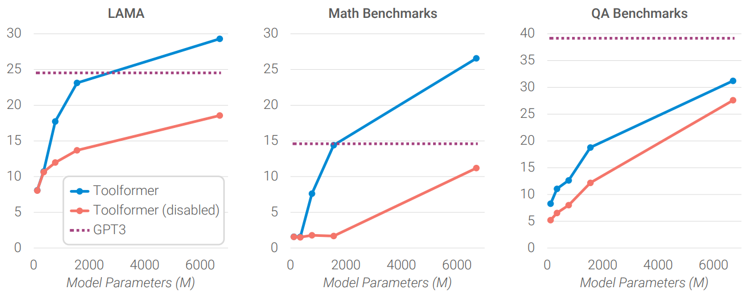
Downstream Tasks
Ability to ask external tools for help affects performance using GPT-J and GPT-2 family (124M, 355M, 775M, 1.6B) for tools: question answering, calculator, Wikipedia search engine

Slide 36
Limitations
Generated independently tools ➔ limitation in using tools in chain (output of one as input for another)
NOT allow to use tool in an interactive way (search engines) ➔ Solution: take advantage of possible results or refine search query by itself
LMs - sensitive to a prompt ➔ sensitive to exact wording (input when deciding to call APIs)
Sample-inefficient (tool-dependent): million results but few thousand useful calls ➔ Solution: iteratively apply our approach, similar to bootstrapping approaches
API calls ➔ NOT consider computational cost for tool-dependent

Slide 37
My confused
Lenient evaluation criteria instead of exact match (tool-dependent), the correct word is in the top k predicted words ➔ what happened in case they used exact match? It too bad?
C* was obtained from C (C* contains the exact same texts as C) and their assumption that finetuning M on C* exposes it to the same content as on C ➔ Why is this true in case there are response of API calls in C* while not in C? Mabe the reason is that when obtaining C* from C, they filtered alters the distribution of training and assume that the remaining examples are close enough to the original distribution so that M’s language modeling abilities remain unaffected? But how?
They used the weighting function to make sure that API calls happen close to where the information provided by the API is actually helpful for the model BUT I can find more clearly explaination for this function nowhere in their paper.
Notes:
The further away from api start idxs, the smaller the weight

Slide 38
Implement (code)
lucidrains/toolformer-pytorch: Implementation of Toolformer, Language Models That Can Use Tools, by MetaAI (github.com)
conceptofmind/toolformer(github.com) - Tool Former Source Code: LLM using API (youtube.com)
xrsrke/toolformer: Implementation of Toolformer: Language Models Can Teach Themselves to Use Tools (github.com)

